Slide 1
Data Science Capstone project
Ziheng Ding
Aug 14, 2021

Slide 2

Outline
Executive Summary
Introduction
Methodology
Results
Conclusion
Appendix

Slide 3

Executive Summary
This capstone project collected historical launch data and then train predictive model to see if the Falcon 9 first stage will land successfully in the future.
The trained model could have a good chance* to predict the result successfully based on current collected data set.
*over 83%

Slide 4

Introduction
SpaceX advertises Falcon 9 rocket launches on its website with a cost of 62 million dollars; other providers cost upward of 165 million dollars each, much of the savings is because SpaceX can reuse the first stage. Therefore, if we can determine if the first stage will land, we can determine the cost of a launch, which can be used if an alternate company wants to bid against SpaceX for a rocket launch.
What data set will be used to train the model?
What features affect successful rate of launch and landing?
How reliable will the trained model be?

Slide 5

Methodology
Data collection methodology:
Requested from SpaceX API and scraped from Wikipedia
Perform data wrangling
Remove irrelevant, replace missing values, and hot encoding data
Perform exploratory data analysis (EDA) using visualization and SQL
Perform interactive visual analytics using Folium and Plotly Dash
Perform predictive analysis using classification models

Slide 6

Methodology

Slide 7
Data collection
Use provided API to get all Falcon launches record and then filter out Falcon 9.
Request and parse the SpaceX launch data using the GET request.
Filter the data frame to only include Falcon 9 launches.
Replace missing values with its mean.
Web scraping Falcon 9 and Falcon heavy launches record from Wikipedia
Request the Falcon9 Launch Wiki page from its URL by using HTTP GET method.
Parse HTML response by using beautiful soup.
Extract all column/variable names from the HTML table header.
Create a data frame by parsing the launch HTML tables

Slide 8
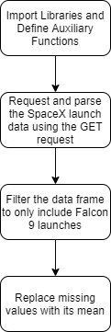
Data collection – SpaceX API
Request records, parse records, filter records, and replace missing values.
https://github.com/xiaotied/ibm_ds_project/blob/main/W1-DataCollectionAPILab.ipynb

Slide 9
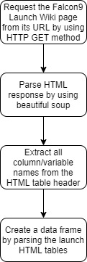
Data collection – Web scraping
Request, parse, extract, and create data frame
https://github.com/xiaotied/ibm_ds_project/blob/main/W1-WebScrapingLab.ipynb

Slide 10
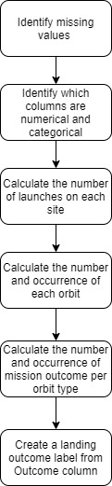
Data wrangling
How data were processed
Identify and calculate the percentage of the missing values in each attribute
Identify which columns are numerical and categorical
Calculate the number of launches on each site
Calculate the number and occurrence of each orbit
Calculate the number and occurrence of mission outcome per orbit type
Create a landing outcome label from Outcome column
https://github.com/xiaotied/ibm_ds_project/blob/main/W1-DataWrangling.ipynb

Slide 11

EDA with data visualization
In the EDA, I used the following charts:
Scatter point chart to visualize the pattern between features
Bar plot to visualize the distribution of data points and comparison the values between features.
Line chart to visualize the relationship between features.
https://github.com/xiaotied/ibm_ds_project/blob/main/W2-EDAwithVisualizationLab.ipynb

Slide 12
EDA with SQL
Summarize performed SQL queries using bullet points
Display the names of the unique launch sites in the space mission
Display 5 records where launch sites begin with the string 'CCA’
Display the total payload mass carried by boosters launched by NASA (CRS)
Display average payload mass carried by booster version F9 v1.1
List the date when the first successful landing outcome in ground pad was achieved.
List the names of the boosters which have success in drone ship and have payload mass greater than 4000 but less than 6000
List the total number of successful and failure mission outcomes
List the names of the booster_versions which have carried the maximum payload mass. Use a subquery
List the records which will display the month names, failure landing_outcomes in drone ship ,booster versions, launch_site for the months in year 2015
Rank the count of successful landing_outcomes between the date 2010-06-04 and 2017-03-20 in descending order.
https://github.com/xiaotied/ibm_ds_project/blob/main/W2-EDAwithSQLlab.ipynb

Slide 13

Build an interactive map with Folium
Summarize what map objects such as markers, circles, lines, etc. you created and added to a folium map
Added markers to all launch sites on map
Visualize the map distribution of launch sites
Marked the success/failed launches for each site on the map
It visualized how many times success/failed
Calculated and shown distances between a launch site to its nearest railway
Tried to understand how SPACX chooses launch site.
https://github.com/xiaotied/ibm_ds_project/blob/main/W3-Interactive%20Visual%20Analytics%20with%20Folium.ipynb

Slide 14
Build a Dashboard with Plotly Dash
A drop-down list has been added to let users select each launch sites and able to interact with dashboard.
A pie chart has been added to show the number of success vs unsuccess for each and all location.
A scatter chart has been added to display the correlation between payload mass and success rate for each and all sites.
A slider bar for payload mass range, which allows users to select payload mass range.
https://github.com/xiaotied/ibm_ds_project/blob/main/W3%20-%20dash/W3-dash.py

Slide 15
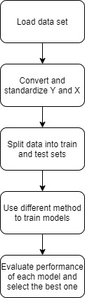
Predictive analysis (Classification)
Add the GitHub URL of your completed predictive analysis lab, as an external reference and peer-review purpose

Slide 16
Results
Exploratory data analysis results
Interactive analytics demo in screenshots
Predictive analysis results

Slide 17

EDA with Visualization

Slide 18
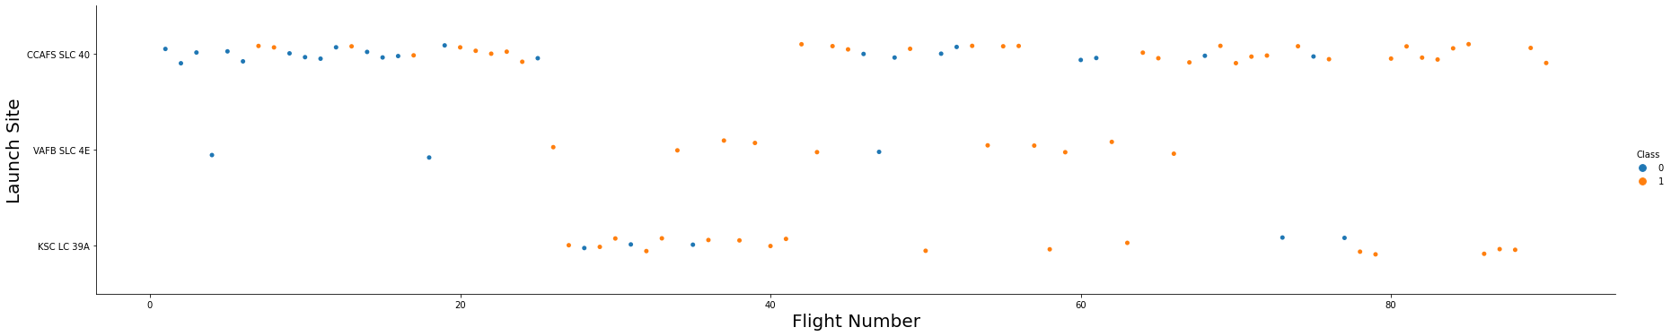
Flight Number vs. Launch Site
The most used location is CCAFS SLC 40
The Flight number after 80 are all succussed

Slide 19
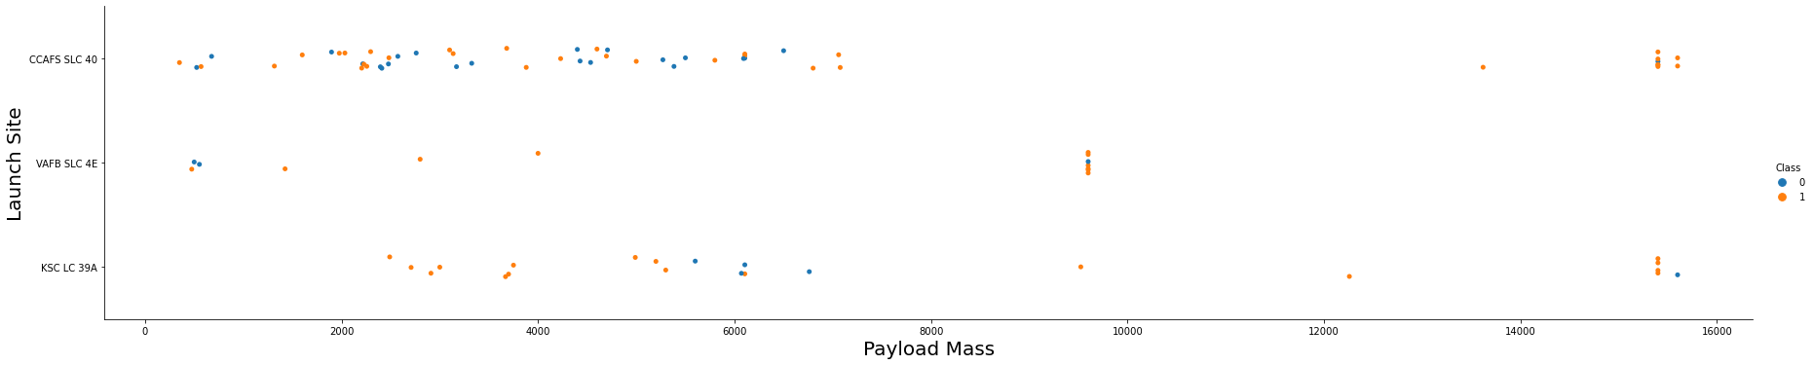
Payload vs. Launch Site
CCAF SLC 40 is most use to launch payload mass under 8000
VAFB SLC $E is most use to launch payload mass around 10000

Slide 20
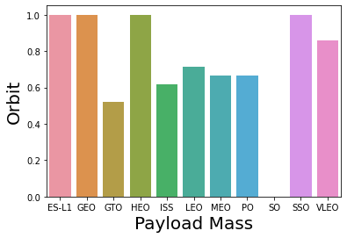
Success rate vs. Orbit type
ES-L1, GEO, HEO, and SSO have the highest success rate, 100%
SO has 0% success rate

Slide 21
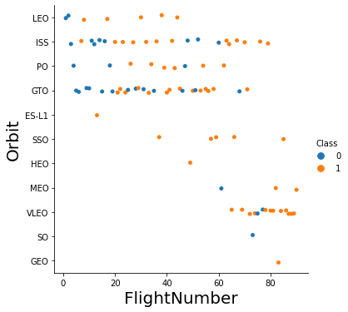
Flight Number vs. Orbit type
In the early launches, most are above GTO
Recent launches most are VLEO

Slide 22
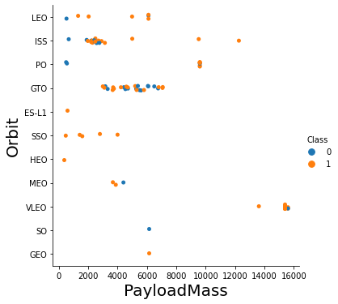
Payload vs. Orbit type
Heavy payload are launch to VLEO
Normal payload are launch to GTO
Light payload are launch to ISS

Slide 23
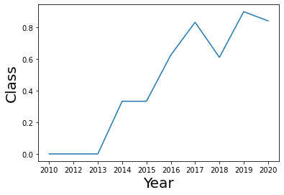
Launch success yearly trend
Success rate increased from 2013 to 2016
There is a decrease in 2017 to 2018
It continue to increase after 2018

Slide 24

EDA with SQL

Slide 25
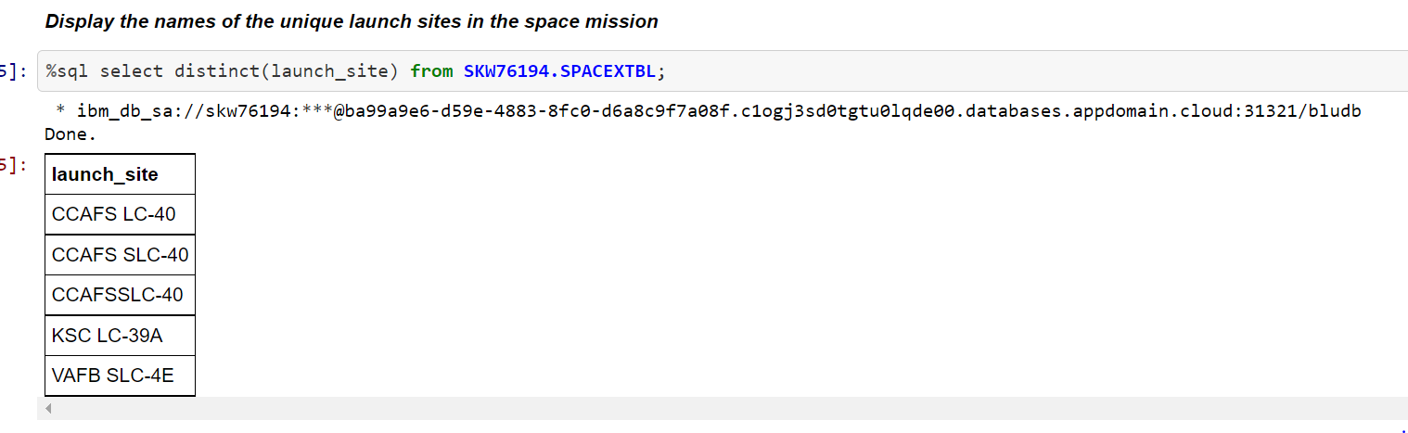
All launch site names
There are five unique launch sites.
CCAFS LC-40, CCAFS SLC 40, KSC LC 39A, VAFB SLC 4E

Slide 26
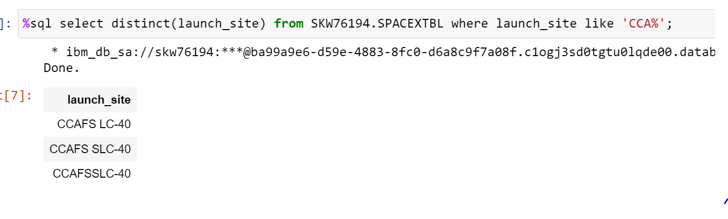
Launch site names begin with `CCA`
There are three launch sites begin with `CCA`
CCAFS LC-40, CCAFS SLC 40, CCAFSSLC 40

Slide 27
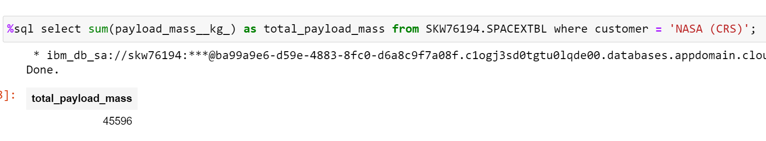
Total payload mass
The total payload carried by boosters from NASA is 45596kg

Slide 28
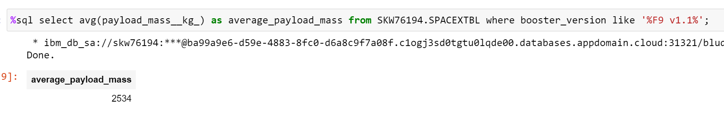
Average payload mass by F9 v1.1
The average payload mass carried by booster version F9 v1.1 is 2534 kg.

Slide 29
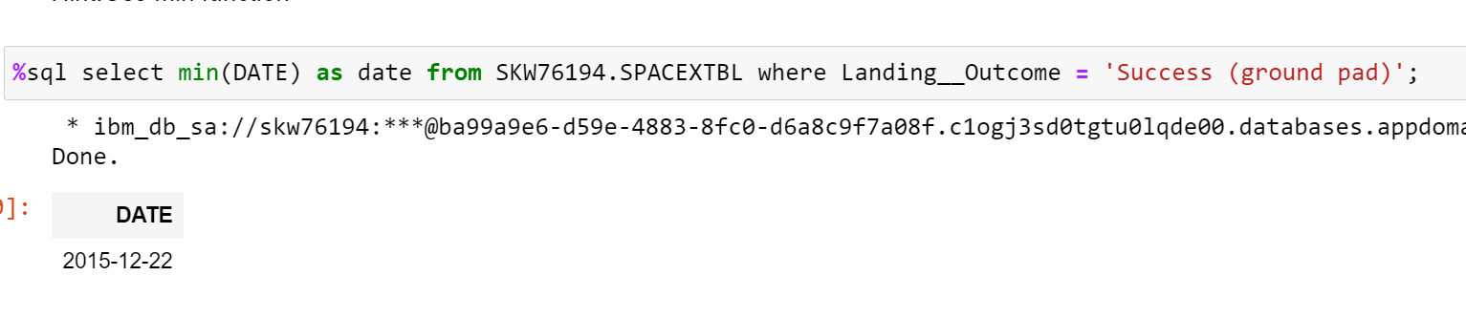
First successful ground landing date
Find the date when the first successful landing outcome in ground pad is 2015-12-22

Slide 30
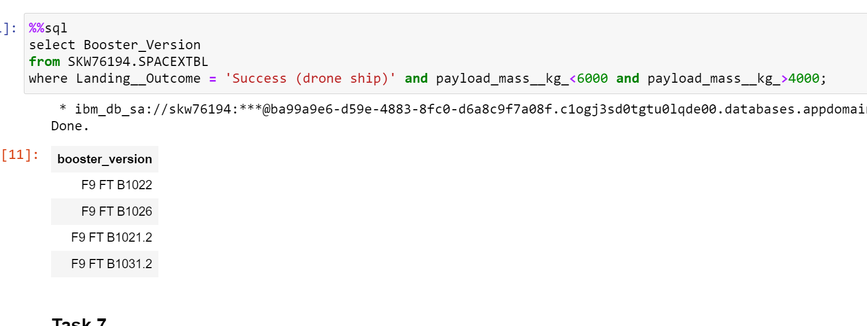
Successful drone ship landing with payload between 4000 and 6000
There are 4 boosters which have success in drone ship and have payload mass greater than 4000 but less than 6000, which list on the right side.

Slide 31
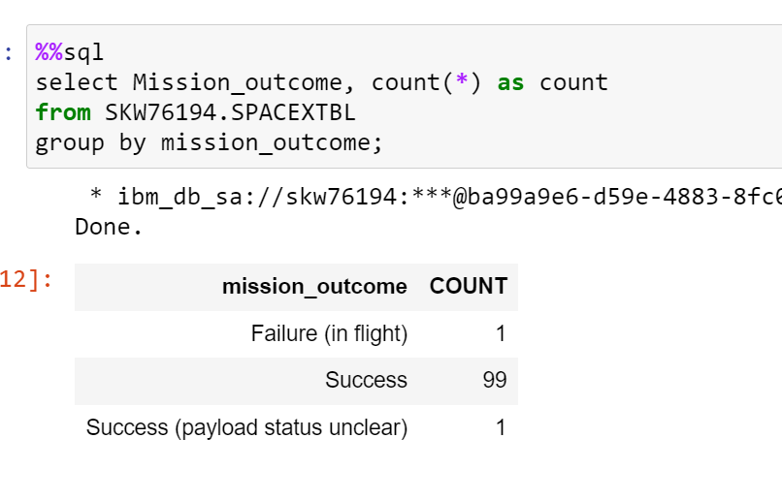
Total number of successful and failure mission outcomes
There are 100 successful outcomes and 1 failure mission outcome.

Slide 32
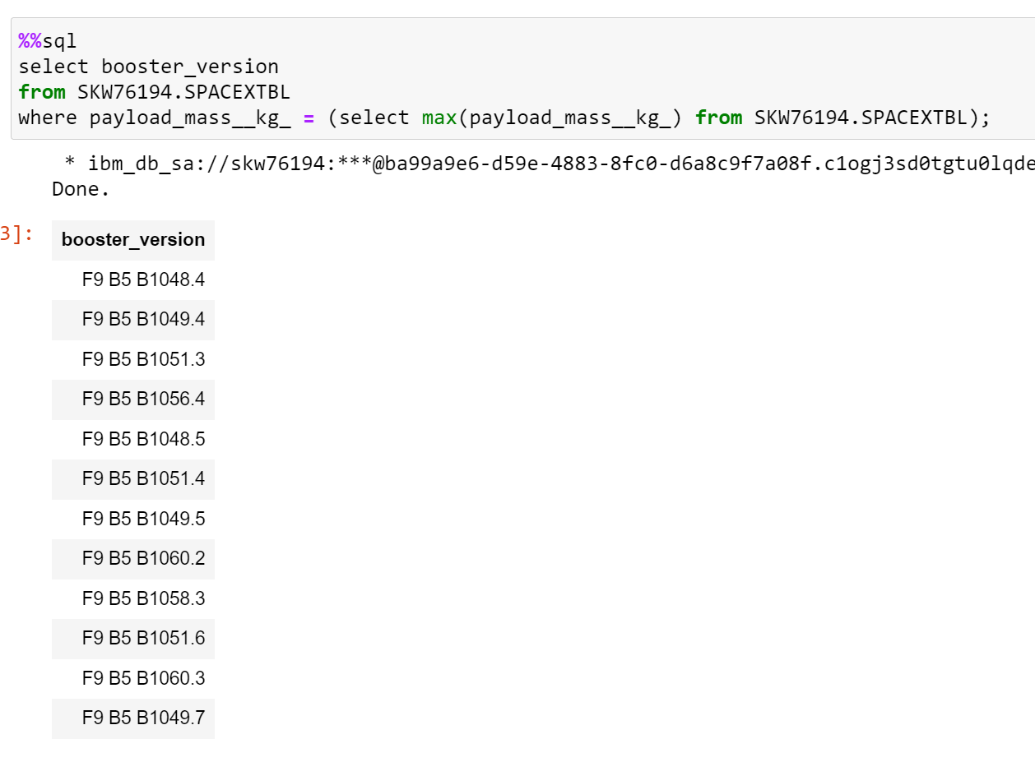
Boosters carried maximum payload
There are 12 booster which have carried the maximum payload mass

Slide 33
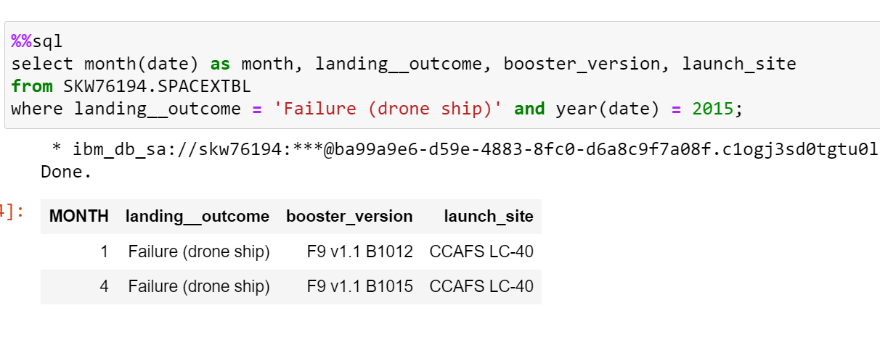
2015 launch records
List the records which will display the month names, failure landing_outcomes in drone ship ,booster versions, launch_site for the months in year 2015
There are two records for 2015

Slide 34
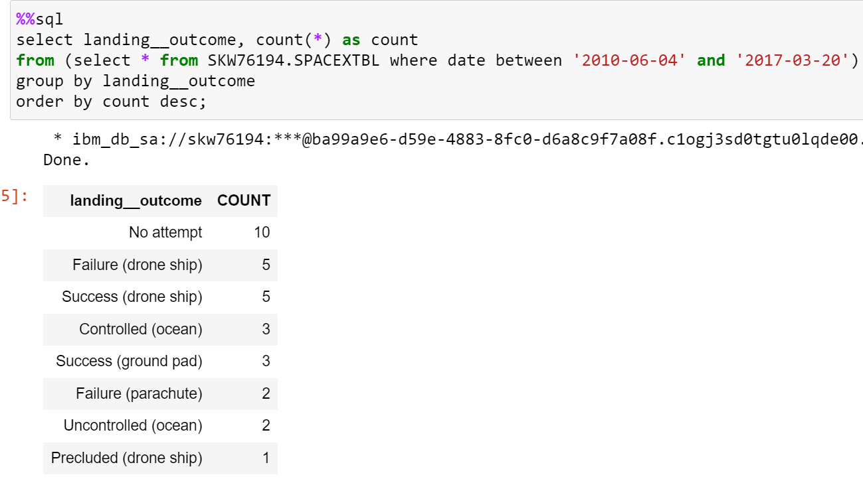
Rank success count between 2010-06-04 and 2017-03-20
Rank the count of successful landing_outcomes between the date 2010-06-04 and 2017-03-20 in descending order.

Slide 35

Interactive map with Folium

Slide 36
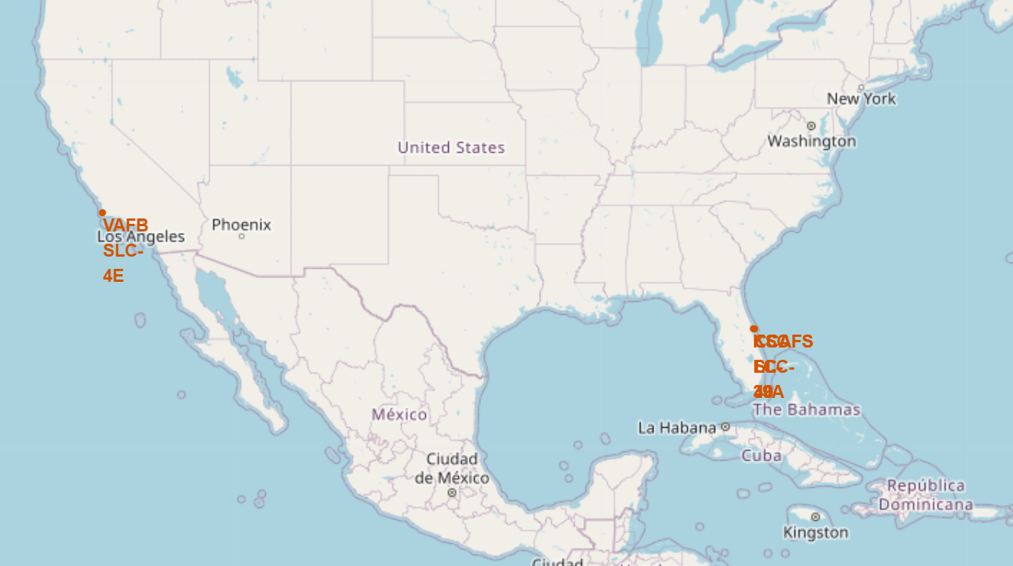
Launch sites’ location
The two places have similar latitude.
Two locations are close to equator line
They are close to coastline

Slide 37
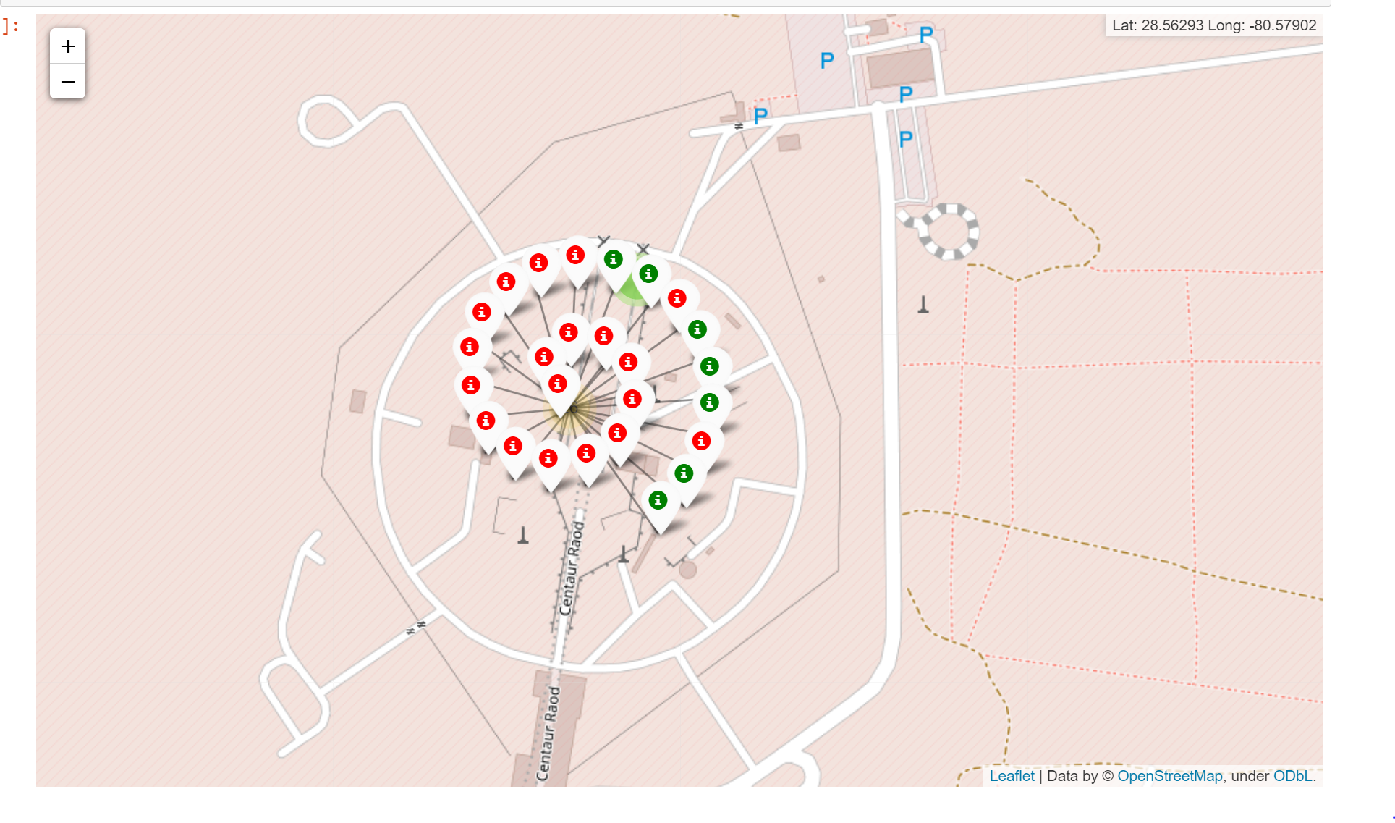
Success Rate for CCAFS LC 40
The map shows all success and unsuccess outcomes for the site CCAFS LC 40
This location has low success rate

Slide 38
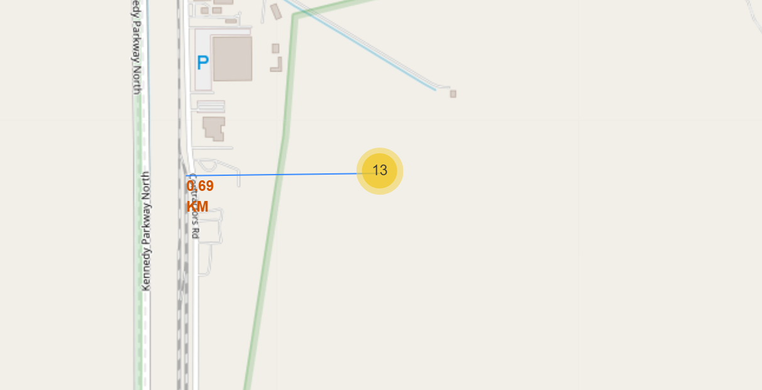
Closest railway to KSC LC-39A
The map shows the closest railway to KSC LC-39A is about 0.69 KM

Slide 39

Build a Dashboard with Plotly Dash

Slide 40
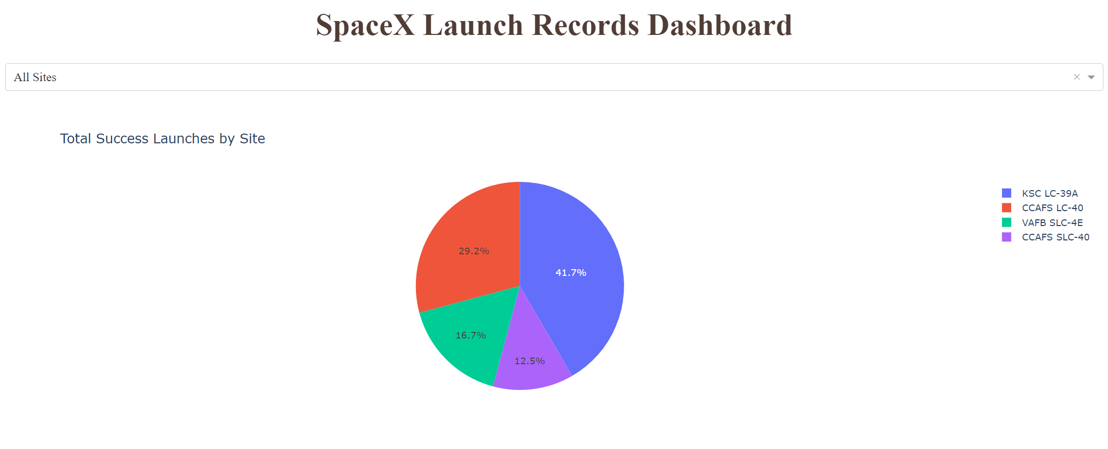
Success Count for All Sites

Slide 41
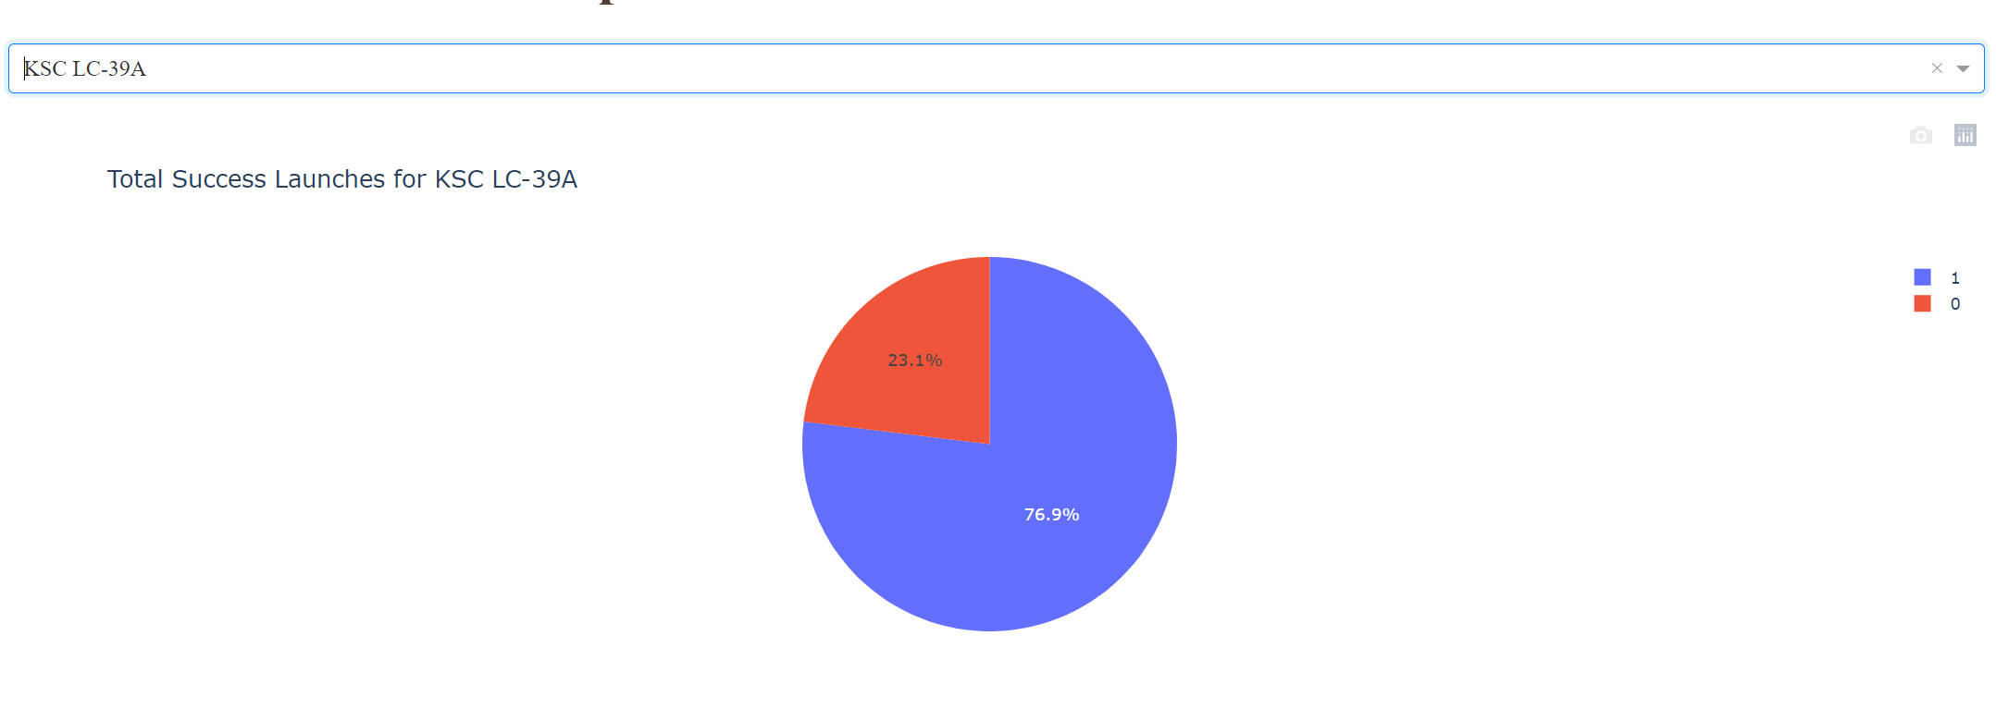
the launch site with highest success ratio

Slide 42
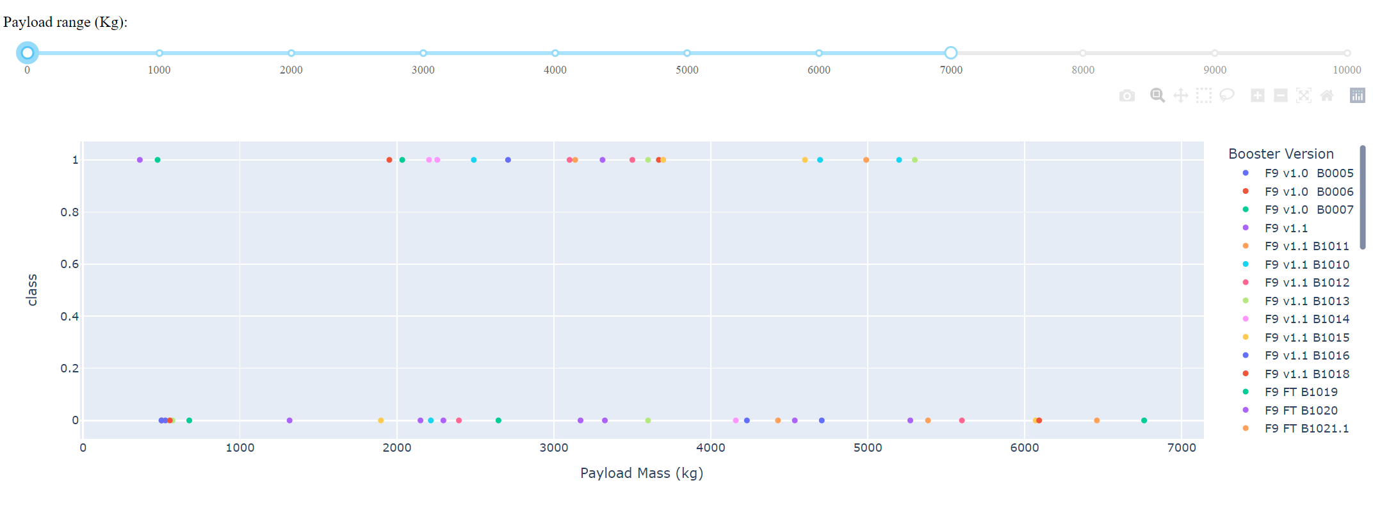
Launch Outcome with Different Payload Ranges
Payload range from 0 to 7000

Slide 43
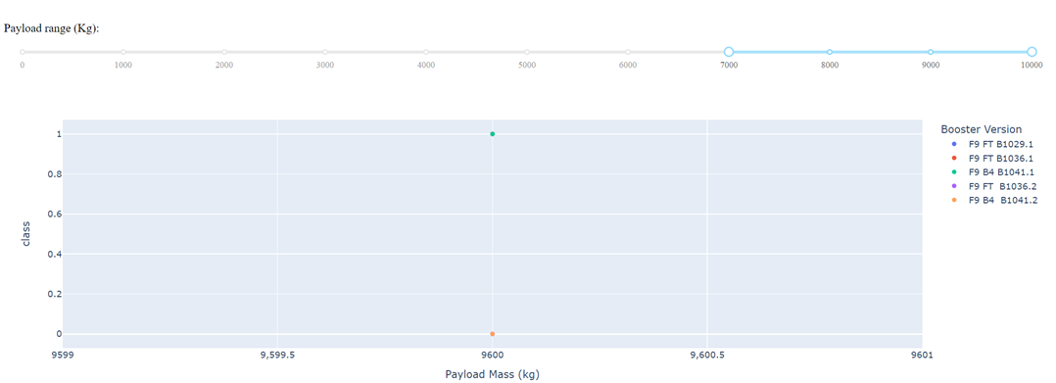
Launch Outcome with Different Payload Ranges
Payload range from 7000 to 10000

Slide 44

Predictive analysis (Classification)

Slide 45
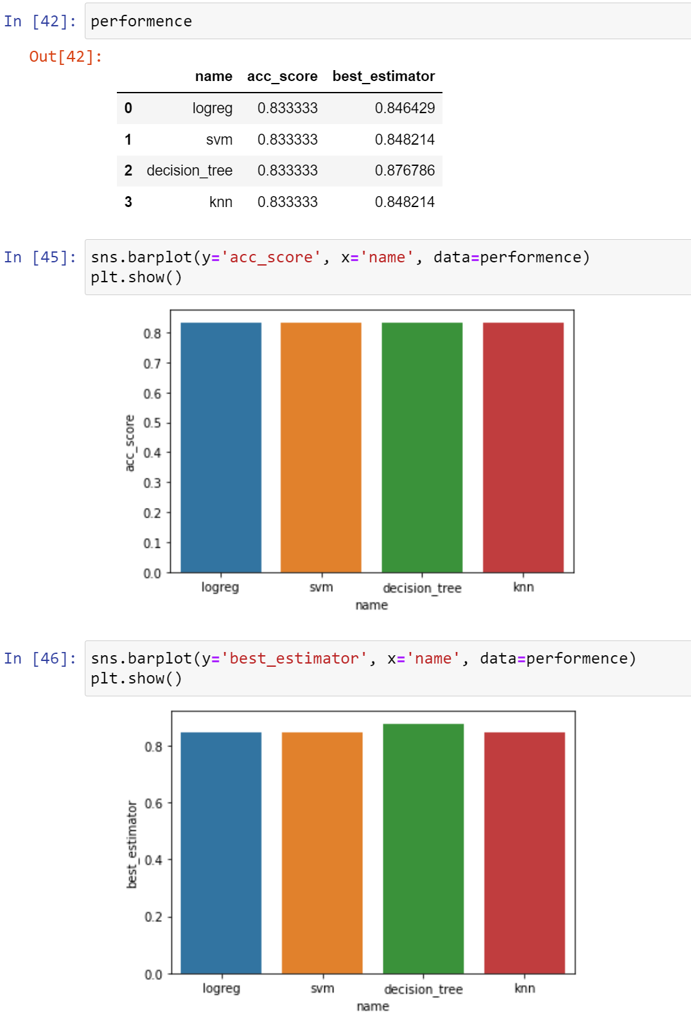
Classification Accuracy
Visualize all the built model accuracy for all built models, in a bar chart
Decision tree has better performance on best_score__

Slide 46
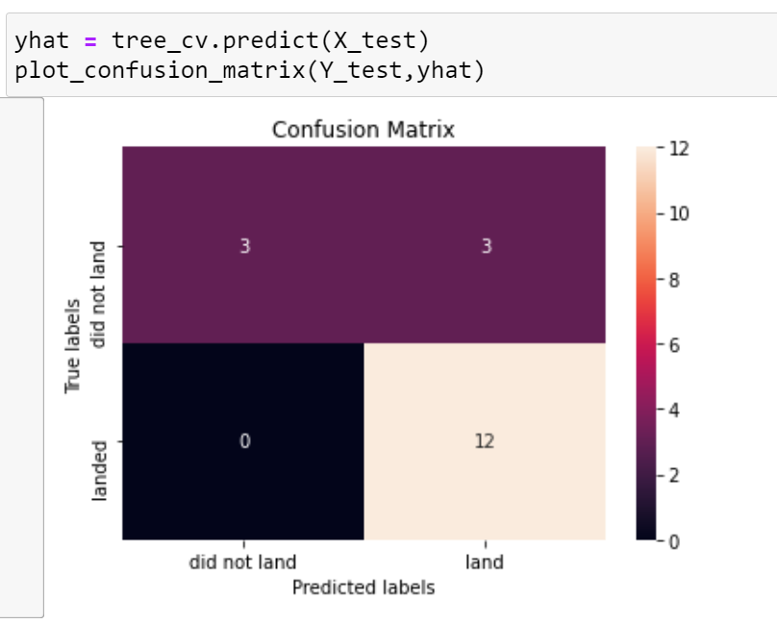
Confusion Matrix for DT
Show the confusion matrix of the best performing model, which is decision tree.

Slide 47

CONCLUSION
There are three model have been trained and they all have very high accuracy, which is 83.33%

Slide 48

APPENDIX
Please refer to https://github.com/xiaotied/ibm_ds_project for any codes.
Thank you!

